Slide 1
Milestone 1 – Team Formation
Notes:
Hi there, my name is DB and I have got the honor of introducing Team 4 or rather SIMTECH to you. Hope the violet is not too violent on the eyes *click*

Slide 2

SIMTECH – Who we are
Sharath Siluveru
Conceptual Model
Aleksei Baidarov
Data Collection & Analysis
Pham Huu Quang
Chief Software Architect
Sai Vivek
Experimental Design
Zeynep Ece Ergin
Validation & Quality Control
Daniel Bokelmann
Project Manager
Milestone 1 – Team Formation
Notes:
Just so you can put some faces to the names, SIMTECH are Sharath, Aleksei, Quang, Sai, ZE and me.

Slide 3
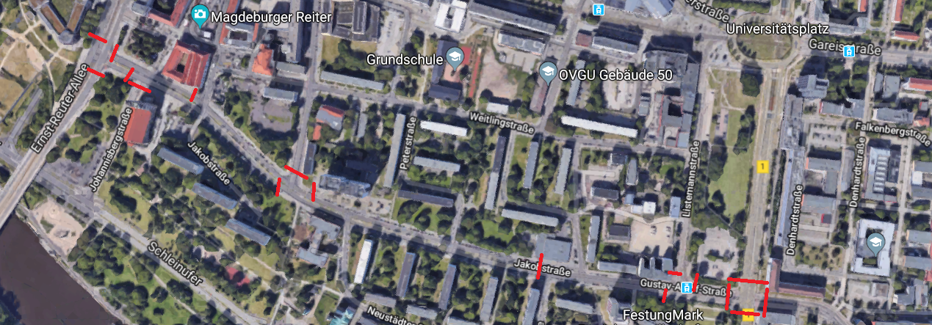
SIMTECH – What‘s the actual situation
Questions regarding a new tram-line:
How many stops, how many tracks could it have?
What effect would a new tram have on existing choke-points?
etc.
Milestone 1 – Team Formation
Notes:
Here‘s the birds perspective, so that you can get a feeling for our task ahead
You can see how large this one is

Slide 4
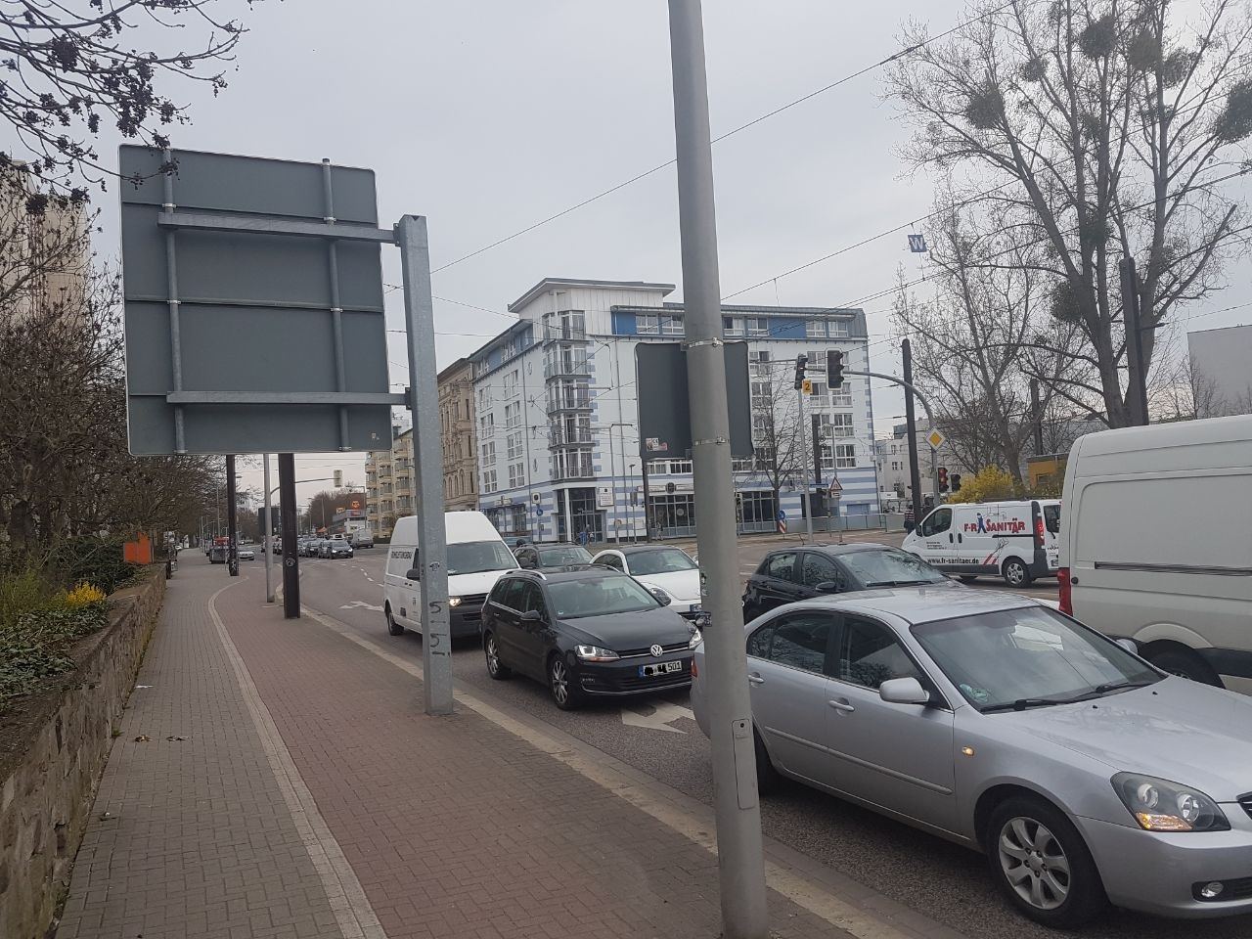
SIMTECH – What we want to do as a team
Create
…value for the customer
…value for our neighbours
Apply
…simulation knowledge
…soft skills
Experience
…teamwork with “strangers“
…building from scratch
…consulting in a sandbox
Milestone 1 – Team Formation
Notes:
Simply put: We want to create value for the customer – if we were real consultants, that would be the second highest priority. Furthermore, this project could actually affect the neighbourhood, some of you might even live there – at least we could see it if we looked out of the window.
First would be getting paid. But as we dont get paid, we still might learn something – getting better at working with strangers for instance, and creating our own frameworks to perform in. From scratch.
This is what we want to achieve in theory.*click*

Slide 5
SIMTECH – What we want the project to be
Effective
…in supporting the customer‘s decision-making
…in planning the project‘s steps
Efficient
…in the usage of time and budget
…in communication
Elegant
…in working together
…in modeling the real infrastructure
…in architecting software
Milestone 1 – Team Formation
Notes:
As I said before, and reiterate, our customer is at the very heart of this project. And it actually would be pretty nice if we could have an impact on this cities growtch.
We want to reach this result with the smallest amount of resources
Elegant needs be explained. Effectiveness and Efficiency, these are words you hear day in and day out in an office.
But elegance, not so much. As we are engineering a product (or a model) it has its place here – building things with cleverness, hiding the complexity

Slide 6
SIMTECH – What‘s expected of a team member
General Individual Performance Criteria:
Punctuality
Preparedness
Cooperativeness
Supportiveness
Dependability
Openess
Reliability
Proactiveness
Commitment
…
A certain degree of professionalism
Milestone 1 – Team Formation
Notes:
There are several things expected of a team member – but the most general expectation is a certain of professionalism – this is a sandbox project, but we‘re all master students and might do paid and qualified work instead

Slide 7
SIMTECH – What we have learned so far
Problem: Slack (Budget usage to date: >4.000€)
Solution: Protocols of meetings with definitions of…
Clear tasks
Clear deadlines&timeboxes
Clear responsibilities
Problem: Structure of meetings
Solution: Agenda to be communicate beforehand
Problem: Responsibilities outside project
Solution: Rolling Wave Planning at the end of every meeting
Milestone 1 – Team Formation
Notes:
Budgets there to be used. And team formation has its costs, so I am not worried yet, given that have still about 80h for each following milestone. But to hold it all together, our next meetings will have proper protocols.
Last week, our meetings have been quite unstructured – the first one more than the second of course. To keep the trend going, the next meeting will be preceded by its agenda, so that preparation is actually possible.
And to complete three strikes, reality shall have ist due – some team members have jobs with irregular working times. To adjust the plans, planning has to be done in a rolling wave – each week will be planned only the week before.
And I‘m done here, I‘d ask you to pose questions later, if there are any. Thank you for your attention.

